Slide 1
Differential Invariants
Continuing the Classification Based Security Schema for Multivariate Public Key Cryptography in the Hope that the Process will Eventually Lead to Reasonable Security Criteria for this Particular Family of Potentially Quantum-Resistant Public Key Cryptosystems

Slide 2
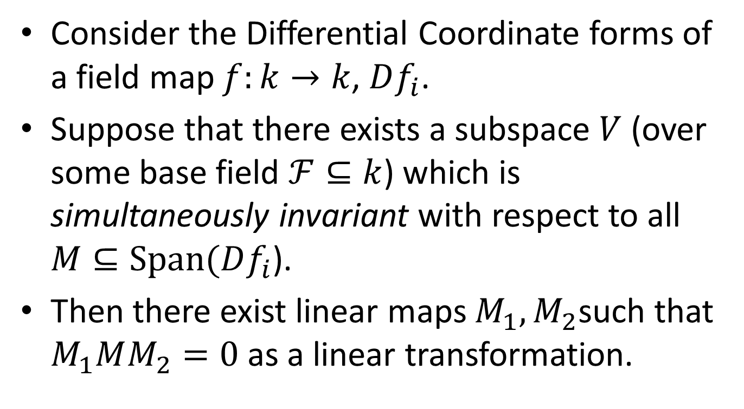
Structure in the Differential
Consider the Differential Coordinate forms of a field map $f:k→k$, $Df_{i}$.
Suppose that there exists a subspace $V$ (over some base field $ℱ⊆k$) which is simultaneously invariant with respect to all $M⊆Span(Df_{i}$).
Then there exist linear maps $M_{1},M_{2}$such that $M_{1}MM_{2}=0$ as a linear transformation.

Slide 3
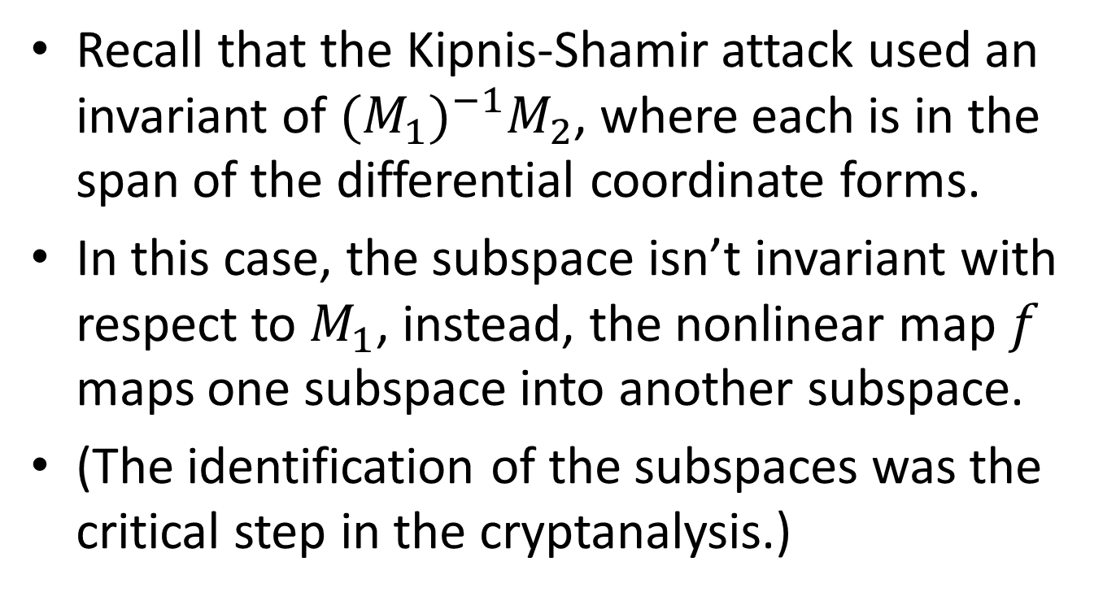
OV Type of Differential Invariant
Recall that the Kipnis-Shamir attack used an invariant of ${(M_{1})}_{}^{−1}M_{2}$, where each is in the span of the differential coordinate forms.
In this case, the subspace isn’t invariant with respect to $M_{1}$, instead, the nonlinear map $f$ maps one subspace into another subspace.
(The identification of the subspaces was the critical step in the cryptanalysis.)

Slide 4
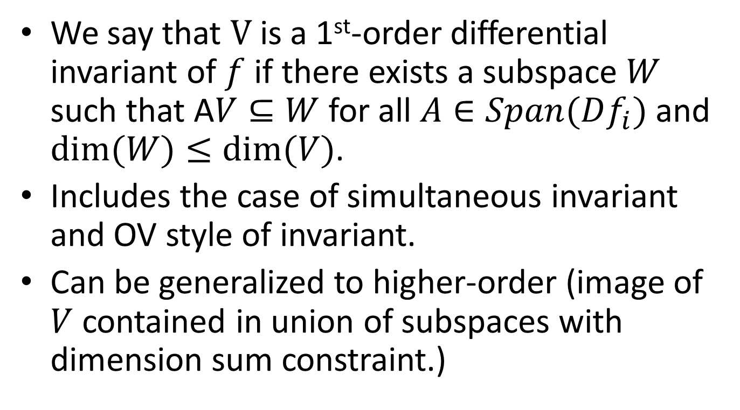
First-Order Differential Invariant
We say that $V$ is a 1st-order differential invariant of $f$ if there exists a subspace $W$ such that A$V⊆W$ for all $A∈Span(Df_{i})$ and $dim⁡(W)≤dim⁡(V)$.
Includes the case of simultaneous invariant and OV style of invariant.
Can be generalized to higher-order (image of $V$ contained in union of subspaces with dimension sum constraint.)

Slide 5
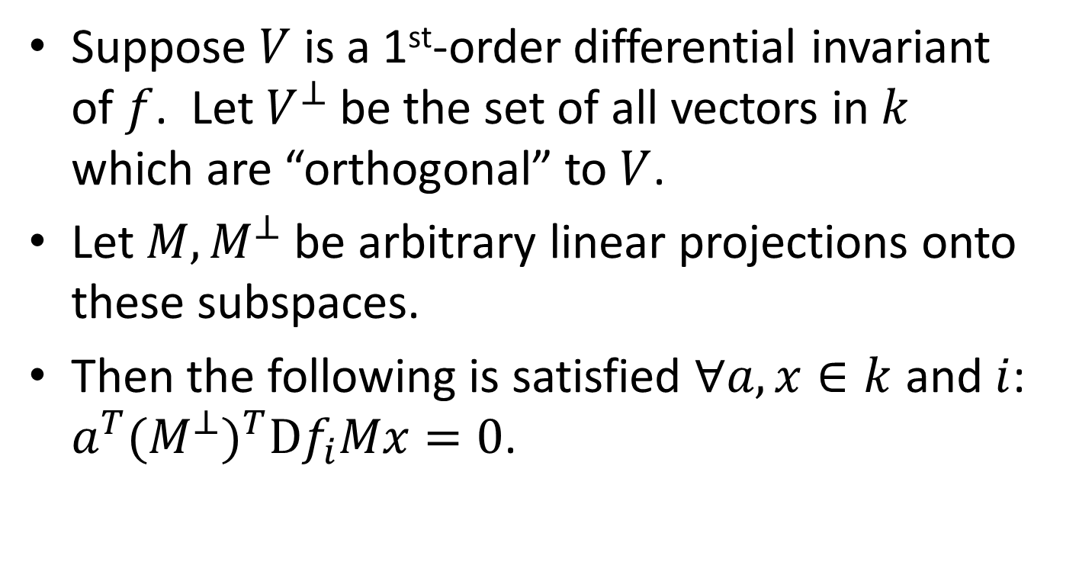
Symmetric Representation
Suppose $V$ is a 1st-order differential invariant of $f$. Let $V^{⊥}$ be the set of all vectors in $k$ which are “orthogonal” to $V$.
Let $M,M^{⊥}$ be arbitrary linear projections onto these subspaces.
Then the following is satisfied $∀a,x∈k$ and $i$: $a^{T}(M^{⊥})^{T}Df_{i}Mx=0$.

Slide 6


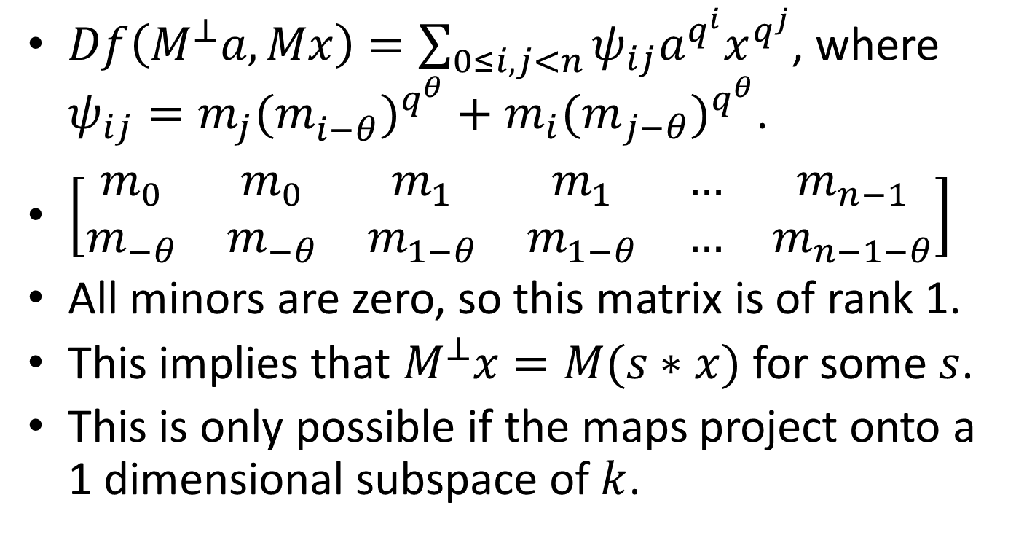









$C^{∗(−)}$Differential Invariants
$Df\left(M^{⊥}a,Mx\right)=\sum_{0≤i,j<n}{ψ_{ij}a^{q^{i}}x^{q^{j}}}$, where $ψ_{ij}=m_{j}(m_{i−θ}^{})^{q^{θ}}+m_{i}{(m}_{j−θ})^{q^{θ}}$.
$\left[\begin{matrix}m_{0} & m_{0} & m_{1} & m_{1} & … & m_{n−1} \\ m_{−θ} & m_{−θ} & m_{1−θ} & m_{1−θ} & … & m_{n−1−θ}\end{matrix}\right]$
All minors are zero, so this matrix is of rank 1.
This implies that $M^{⊥}x=M(s∗x)$ for some $s$.
This is only possible if the maps project onto a 1 dimensional subspace of $k$.
$$⊥$$
$$⊥$$
$$⊥$$
$$⊥$$
$$⊥$$
$$q^{θ}$$
$$q^{θ}$$
$$q^{θ}$$
$$⊥$$
$$⊥$$
$$q^{θ}$$
$$⊥$$
$$q^{θ}$$

Slide 7
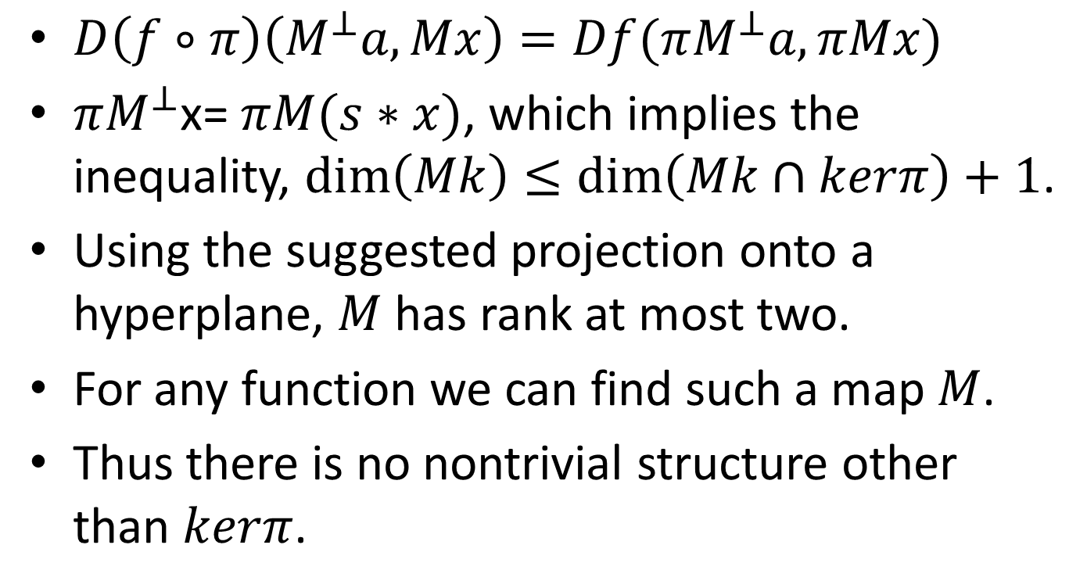
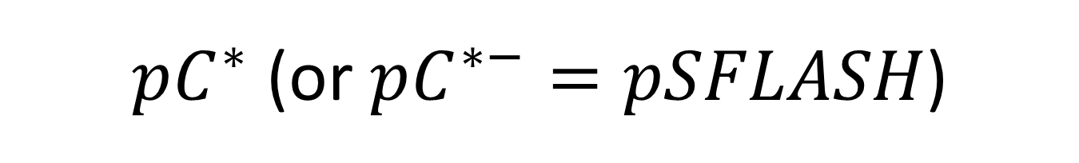
$pC^{∗}$ (or $pC^{∗−}=pSFLASH$)
$D\left(f∘π\right)\left(M^{⊥}a,Mx\right)=Df(πM^{⊥}a,πMx)$
$πM^{⊥}$x= $πM(s∗x)$, which implies the inequality, $dim\left(Mk\right)≤\dim\left(Mk∩kerπ\right)+1$.
Using the suggested projection onto a hyperplane, $M$ has rank at most two.
For any function we can find such a map $M$.
Thus there is no nontrivial structure other than $kerπ$.

